Slide 1
MACHINE LEARNING

Slide 2
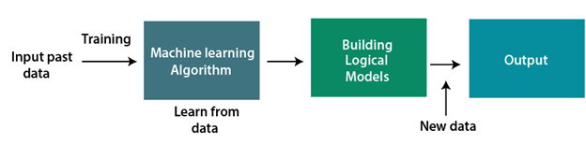
INTRODUCTION
Machine learning enables a machine to automatically learn from data, improve performance from experiences, and predict things without being explicitly programmed.

Slide 3
MACHINE LEARNING APPROACH
Supervised Learning
Unsupervised Learning
Reinforcement Learning

Slide 4
SUPERVISED LEARNING
Supervised learning is a type of machine learning method in which we provide sample labelled data to the machine learning system in order to train it, and on that basis, it predicts the output.
The system creates a model using labelled data to understand the datasets and learn about each data, once the training and processing are done then we test the model by providing a sample data to check whether it is predicting the exact output or not.
The goal of supervised learning is to map input data with the output data. The supervised learning is based on supervision, and it is the same as when a student learns things in the supervision of the teacher. The example of supervised learning is spam filtering.

Slide 5
Supervised learning can be grouped further in two categories of algorithms:
Classification
Regression
Classification
A classification problem is when the output variable is a category, such as “red” or “blue” or “disease” and “no disease”. A classification model attempts to draw some conclusion from observed values. Given one or more inputs a classification model will try to predict the value of one or more outcomes.
For example, when filtering emails “spam” or “not spam”, when looking at transaction data, “fraudulent”, or “authorized”.

Slide 6
Regression
A regression problem is when the output variable is a real or continuous value, such as “salary” or “weight”. Many different models can be used, the simple linear regression and multi linear regression. Example:
ID | Height | Age | Weight
1 | 5 | 45 | 77
2 | 5.11 | 26 | 47
3 | 5.6 | 30 | 55
4 | 5.9 | 34 | 59
5 | 4.6 | 40 | 73

Slide 7
UNSUPERVISED LEARNING
Unsupervised learning is a learning method in which a machine learns without any supervision.
The training is provided to the machine with the set of data that has not been labelled, classified, or categorized, and the algorithm needs to act on that data without any supervision. The goal of unsupervised learning is to restructure the input data into new features or a group of objects with similar patterns.

Slide 8
In unsupervised learning, we don't have a predetermined result. The machine tries to find useful insights from the huge amount of data.
Example: Suppose the unsupervised learning algorithm is given an input dataset containing images of different types of cats and dogs. The algorithm is never trained upon the given dataset, which means it does not have any idea about the features of the dataset. The task of the unsupervised learning algorithm is to identify the image features on their own. Unsupervised learning algorithm will perform this task by clustering the image dataset into the groups according to similarities between images.

Slide 9
It can be further classified into two categories of algorithms:
1.Clustering
Clustering is a method of grouping the objects into clusters such that objects with most similarities remains into a group and has less or no similarities with the objects of another group. Cluster analysis finds the commonalities between the data objects and categorizes them as per the presence and absence of those commonalities.The goal of clustering is to identify patterns and relationships in the data without any prior knowledge of the data’s meaning.

Slide 10
2.Association
Association rule learning is also known as association rule mining is a common technique used to discover associations in unsupervised machine learning. This technique is a rule-based ML technique that finds out some very useful relations between parameters of a large data set. This technique is basically used for market basket analysis that helps to better understand the relationship between different products.
Example:shopping stores use algorithms based on this technique to find out the relationship between the sale of one product w.r.t to another’s sales based on customer behavior. Like if a customer buys milk, then he may also buy bread, eggs, or butter. Once trained well, such models can be used to increase their sales by planning different offers.

Slide 11
REINFORCEMENT LEARNING
Reinforcement Learning is a part of machine learning. Here, agents are self-trained on reward and punishment mechanisms. It’s about taking the best possible action or path to gain maximum rewards and minimum punishment through observations in a specific situation. It acts as a signal to positive and negative behaviours. Essentially an agent (or several) is built that can perceive and interpret the environment in which is placed, furthermore, it can take actions and interact with it.

Slide 12

Here what do you see?
You can see a dog and a master. Let’s imagine you are training your dog to get the stick. Each time the dog gets a stick successfully, you offered him a feast (a bone let’s say). Eventually, the dog understands the pattern, that whenever the master throws a stick, it should get it as early as it can to gain a reward (a bone) from a master in a lesser time.

Slide 13
MACHINE LEARNING PROCESS STEPS
Define the objective of the Problem statement
Data Gathering
Exploratory Data Analysis
Data Preparation
Building a Machine Learning Model
Model Evaluation & Optimization
Prediction

Slide 14
Define the objective of the Problem statement
A problem statement is usually one or two sentences to explain the problem your process improvement project will address. In general, a problem statement will outline the negative points of the current situation and explain why this matters.
Data Gathering
For the purpose of developing our machine learning model, our second step would be to gather relevant data that can be used to differentiate between the 2 fruits. Different parameters can be used to classify a fruit as either an orange or apple.

Slide 15
The first feature would be the color of the fruit itself and the second one being the shape of the fruit. Using these features, we would hope that our model can accurately differentiate between the 2 fruits.
Color | Shape | Apple or Orange?
Red | Round Conical | Apple
Orange | Round | Orange

Slide 16
Exploratory Data Analysis
Data Overview
Understand the dataset size (rows, columns).
Check the data types of each column.
Look at the first few rows using head()
Descriptive Statistics
Compute summary statistics like mean, median, standard deviation, and percentiles.
Example data.describe()
Data Visualization
Visualizing the data helps identify trends, patterns, and outliers.
Histograms: For distributions of numerical data.
Box Plots: To detect outliers.
Scatter plots: To analyze relationships between two variables.
Heatmaps: For correlation between features.

Slide 17
Missing Values
Identify and handle missing data, either by:
Imputation (e.g., filling with mean/median/mode).
Removing rows/columns with too many missing values.
Outlier Detection
Use box plots or statistical methods (e.g., Z-score, IQR) to identify and handle outliers.
Feature Relationships
Use correlation analysis to find relationships between variables.
Explore categorical vs. numerical relationships using group statistics or count plots.
Data Distribution
Check for skewness and normality in data distributions.
Transformations like logarithmic scaling may help normalize skewed data.

Slide 18
Data Preparation
Once we have gathered the data for the two features, our next step would be to prepare data for further steps. A key focus of this stage is to recognize and minimize any potential biases in our data sets for the 2 features. First, we would randomize the order of our data for the 2 fruits.
Another major component of data preparation is breaking down the data sets into 2 parts. The larger part (~80%) would be used for training the model while the smaller part (~20%) is used for evaluation purposes. This is important because using the same data sets for both training and evaluation would not give a fair assessment of the model’s performance in real world scenarios. Apart from the data split, additional steps are taken to refine the data sets.

Slide 19
Well-prepared data for your model can improve its efficiency. It can help in reducing the blind spots of the model which translates to greater accuracy of predictions. Therefore, it makes sense to deliberate and review your data sets so that it can be fine-tuned for producing better and meaningful results.

Slide 20
Building a Machine Learning Model
Selecting the right machine learning model plays a pivotal role in building of successful model, with the presence of numerous algorithms and techniques available easily, choosing the most suitable model for a given problem significantly impacts the accuracy and performance of the model. The process of selecting the right machine learning model involves several considerations, some of which are:
Firstly, understanding the nature of the problem is an essential step, as our model nature can be of any type like classification, regression, clustering or more, different types of problems require different algorithms to make a predictive model.

Slide 21
Secondly, familiarizing yourself with a variety of machine learning algorithms suitable for your problem type is crucial. Evaluate the complexity of each algorithm and its interpretability. We can also explore more complex models like deep learning may help in increasing your model performance but are complex to interpret.

Slide 22
Model Evaluation & Optimization
You will have to check the machine created against your evaluation data set that contains inputs that the model does not know and verify the precision of your already trained model. If the accuracy is less than or equal to 50%, that model will not be useful since it would be like tossing a coin to make decisions. If you reach 90% or more, you can have good confidence in the results that the model gives you.If it is less than 90%,do the following optimization steps:

Slide 23
Add Useful Features
You can improve model performance by adding features that encode information not yet encoded by your existing features. You can find linear correlations between individual features and labels by using correlation matrices. To detect nonlinear correlations between features and labels, you must train the model with and without the feature, or combination of features, and check for an increase in model quality. You must justify the feature's inclusion by an increase in model quality.

Slide 24
Tune Hyperparameters
Hyperparameters are parameters that are set before the training process begins and control the behavior of the machine learning model.
You found values of hyperparameters that make your model work. However, these hyperparameter values can still be tuned. You can tune the values manually by trial and error, but manual tuning is time consuming. Instead, consider using an automated hyperparameter tuning service, such as Cloud ML Hyperparameter Tuning.

Slide 25
3. Tune Model Depth and Width
While debugging your model, you only increased model depth and width. In contrast, during model optimization, you either increase or decrease depth and width depending on your goals.

Slide 26
Model Prediction
You are now ready to use your Machine Learning model inferring results in real-life scenarios.During model deployment, it's essential to ensure that the system can handle high user loads, operate smoothly without crashes, and be easily updated.

Slide 27
ML ALGORITHMS
Supervised Learning
Supervised learning is a type of machine learning where the model is trained using labeled data. This means that for each input in the training dataset, the correct output (label) is already known. The goal is for the model to learn the mapping from inputs to outputs so it can accurately predict the output for new, unseen inputs.
Types of Supervised Learning:
Classification: Predict discrete labels (categories).
Regression: Predict continuous values.

Slide 28
CLASSIFICATION ALGORITHMS
K-Nearest Neighbours
Naïve Bayes Algorithm
Decision Tree Algorithm
Random Forest Algorithm
Support Vector Machine Algorithm
Logistic Regression Algorithm

Slide 29
K-Nearest Neighbours
K-Nearest Neighbour is one of the simplest Machine Learning algorithms based on Supervised Learning technique.
K-NN algorithm assumes the similarity between the new case/data and available cases and put the new case into the category that is most similar to the available categories.
K-NN algorithm stores all the available data and classifies a new data point based on the similarity. This means when new data appears then it can be easily classified into a well suite category by using K- NN algorithm.
K-NN algorithm can be used for Regression as well as for Classification but mostly it is used for the Classification problems.

Slide 30
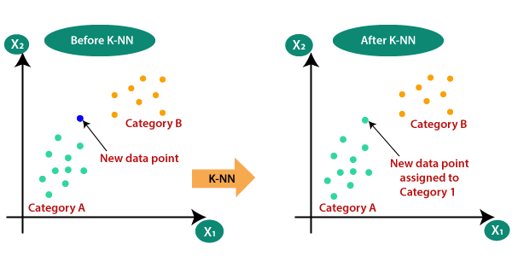
Working of knn algorithm
Suppose there are two categories, i.e., Category A and Category B, and we have a new data point x1, so this data point will lie in which of these categories. To solve this type of problem, we need a K-NN algorithm. With the help of K-NN, we can easily identify the category or class of a particular dataset. Consider the below diagram:

Slide 31
How does K-NN work?
The K-NN working can be explained on the basis of the below algorithm:
Step-1: Select the number K of the neighbors
Step-2: Calculate the Euclidean distance between test data and each data points in the train data
Step-3: Take the K nearest neighbors as per the calculated Euclidean distance.
Step-4: Among these k neighbors, count the number of the data points in each category.
Step-5: Assign the new data points to that category for which the number of the neighbor is maximum.
Step-6: Our model is ready

Slide 32
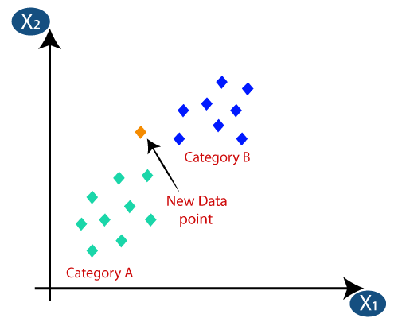
Suppose we have a new data point and we need to put it in the required category. Consider the below image:

Slide 33
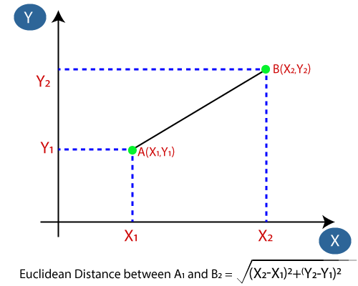
Firstly, we will choose the number of neighbors, so we will choose the k=5.
Next, we will calculate the Euclidean distance between the data points. The Euclidean distance is the distance between two points, which we have already studied in geometry. It can be calculated as:

Slide 34
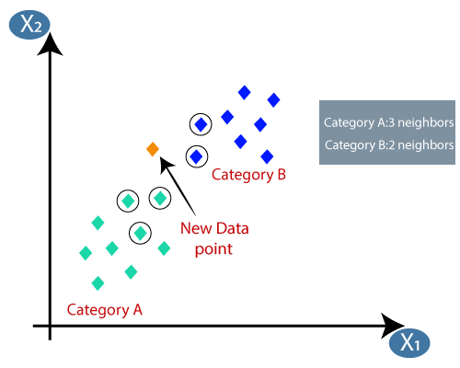
By calculating the Euclidean distance we got the nearest neighbors, as three nearest neighbors in category A and two nearest neighbors in category B. Consider the below image:

Slide 35
As we can see the 3 nearest neighbors are from category A, hence this new data point must belong to category A.

Slide 36
Age | Loan | Risk
25 | 40 | N
45 | 80 | N
52 | 18 | N
23 | 95 | Y
60 | 100 | Y
Predict the risk factor when age=48 and loan=150 assume k=3

Slide 37
Step 1:Find the distance between test data and each data point in the train data using Euclidean distance
D=SQRT((x1-y1)^2+(x2-y2)^2)
x1=48 x2=150
y1=25 y2=40
D=SQRT((48-25)^2+(150-40)^2)
=SQRT((23)^2+(110)^2)
=SQRT(529+12100)
=SQRT(12629) =112.378
x1=48 x2=150
y1=45 y2=80
D=SQRT((48-45)^2+(150-80)^2)
=SQRT((3)^2+(70)^2)
=SQRT(9+4900)
=SQRT(4909) =70.06

Slide 38
Step 2:After finding Euclidean distance find out the nearest neighbours.
Age | Loan | Risk | Euclidean Distance | Rank
25 | 40 | N | 112.378 | 4
45 | 80 | N | 70.06 | 3
52 | 18 | N | 132.06 | 5
23 | 95 | Y | 60.4 | 2
60 | 100 | Y | 51.4 | 1

Slide 39
Step 3:Using the k value select the top(based up on rank) k point k data points
here k=3 we can select 3 data points
Step 4:Neighbour data points on test data.
Age | Loan | Risk
45 | 80 | N
23 | 95 | Y
60 | 100 | Y
Step5: we can choose majority voting of the output value
that means the output value is Y

Slide 40
Naive Bayes Algorithm
Naive Bayes algorithm is a supervised learning algorithm, which is based on Bayes theorem and used for solving classification problems.
It is mainly used in text classification that includes a high-dimensional training dataset.
Naive Bayes Classifier is one of the simple and most effective Classification algorithms which helps in building the fast machine learning models that can make quick predictions.
It is a probabilistic classifier, which means it predicts on the basis of the probability of an object.
Some popular examples of Naive Bayes Algorithm are spam filtration, Sentimental analysis, and classifying articles.

Slide 41
Why is it called Naive Bayes?
The Naive Bayes algorithm is comprised of two words Naive and Bayes, Which can be described as:
Naive: It is called Naive because it assumes that the occurrence of a certain feature is independent of the occurrence of other features. Such as if the fruit is identified on the bases of color, shape, and taste, then red, spherical, and sweet fruit is recognized as an apple. Hence each feature individually contributes to identify that it is an apple without depending on each other.
Bayes: It is called Bayes because it depends on the principle of Bayes' Theorem.

Slide 42
Bayes' Theorem:
Bayes' theorem is also known as Bayes' Rule or Bayes' law, which is used to determine the probability of a hypothesis with prior knowledge. It depends on the conditional probability.
The formula for Bayes' theorem is given as:
Where,
P(A|B) is Posterior probability: Probability of hypothesis A on the observed event B.
P(B|A) is Likelihood probability: Probability of the evidence given that the probability of a hypothesis is true.
P(A) is Prior Probability: Probability of hypothesis before observing the evidence.
P(B) is Marginal Probability: Probability of Evidence.

Slide 43
Types of Naive Bayes Model
There are three types of Naive Bayes Model, which are given below:
Gaussian: Continuous data (assumes that the data follows a Gaussian/normal distribution).The features are distributed normally (bell-shaped curve).For example,Predicting whether a student will pass/fail based on exam scores.
Multinomial: Discrete data (e.g., counts of words or occurrences).Features represent the frequency of events (e.g., word counts in text classification).For example, Spam detection, sentiment analysis, or document classification
Bernoulli: Binary data (0 or 1, indicating absence or presence of a feature).Features are binary (e.g., whether a word appears in a document).For example, Text classification with binary word occurrences (e.g., "does the word 'cheap' appear in the email?").

Slide 44
No | Outlook | Play
0 | rainy | yes
1 | sunny | yes
2 | overcast | yes
3 | overcast | yes
4 | sunny | no
5 | rainy | yes
6 | sunny | yes
7 | overcast | yes
8 | rainy | no
9 | sunny | no
10 | sunny | yes
11 | rainy | no
12 | overcast | yes
13 | overcast | yes

Slide 45
Now, we want to classify if "Play" is yes or no for a given Outlook = 'rainy'.
Frequency table from the weather condition
weather | yes | no
overcast | 5 | 0
rainy | 2 | 2
sunny | 3 | 2
total | 10 | 4

Slide 46
Likelihood table weather conditions
weather | yes | no | total
overcast | 5 | 0 | 5/14=0.35
rainy | 2 | 2 | 4/14=0.29
sunny | 3 | 2 | 5/14=0.35
total | 10/14=0.71 | 4/14=0.29

Slide 47
Apply Naive Bayes Formula
We calculate P(Play=yes∣Outlook=rainy) and P(Play = no| Outlook = rainy)
For "Play = yes":
P(yes∣rainy)=(P(rainy|yes)×P(yes))/P(rainy)
=(2/10)*0.71/(4/14)
=0.497
For "Play = no":
P(no∣rainy)=P(no)×P(rainy∣no)/P(rainy)
=0.29*(2/4)/(4/14)
=0.5075
Since P(yes∣rainy)<P(no∣rainy),
classify "Play = no" for Outlook = rainy.

Slide 48
Decision Tree Algorithm
Decision trees can be constructed by an algorithmic approach that can split the dataset in different ways based on different conditions. Decisions trees are the most powerful algorithms that falls under the category of supervised algorithms.
They can be used for both classification and regression tasks. The two main entities of a tree are decision nodes, where the data is split and leaves, where we got outcome. The example of a binary tree for predicting whether a person is fit or unfit providing various information like age, eating habits and exercise habits, is given below −

Slide 49
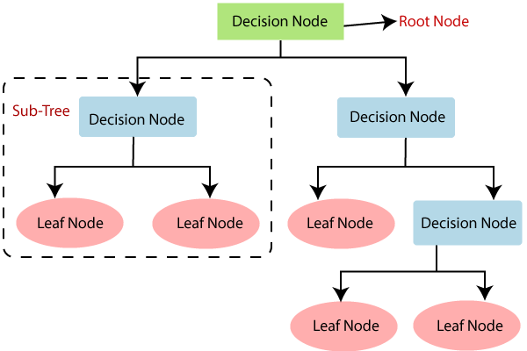

Slide 50
Root Node: Root node is from where the decision tree starts. It represents the entire dataset, which further gets divided into two or more homogeneous sets.
Leaf Node: Leaf nodes are the final output node, and the tree cannot be segregated further after getting a leaf node.
Splitting: Splitting is the process of dividing the decision node/root node into sub-nodes according to the given conditions.
Branch/Subtree: A tree formed by splitting the tree.
Parent/Child node: The root node of the tree is called the parent node, and other nodes are called the child nodes.

Slide 51
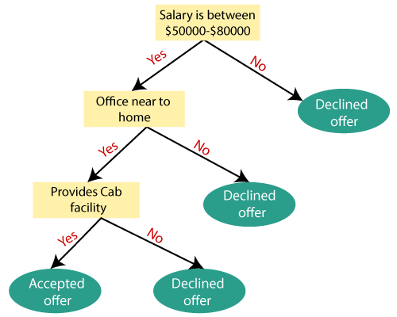
Example: Suppose there is a candidate who has a job offer and wants to decide whether he should accept the offer or Not. So, to solve this problem, the decision tree starts with the root node . The root node splits further into the next decision node (distance from the office) and one leaf node based on the corresponding labels. The next decision node further gets split into one decision node (Cab facility) and one leaf node. Finally, the decision node splits into two leaf nodes (Accepted offers and Declined offer). Consider the below diagram:

Slide 52
Random Forest
Random Forest is a popular machine learning algorithm that belongs to the supervised learning technique. It can be used for both Classification and Regression problems in ML. It is based on the concept of ensemble learning, which is a process of combining multiple classifiers to solve a complex problem and to improve the performance of the model.
As the name suggests, "Random Forest is a classifier that contains a number of decision trees on various subsets of the given dataset and takes the average to improve the predictive accuracy of that dataset." Instead of relying on one decision tree, the random forest takes the prediction from each tree and based on the majority votes of predictions, and it predicts the final output.

Slide 53
How does Random Forest algorithm work?
Random Forest works in two-phase first is to create the random forest by combining N decision tree, and second is to make predictions for each tree created in the first phase.
The Working process can be explained in the below steps and diagram:
Step-1: Select random K data points from the training set.
Step-2: Build the decision trees associated with the selected data points (Subsets).
Step-3: Choose the number N for decision trees that you want to build.
Step-4: Repeat Step 1 & 2.
Step-5: For new data points, find the predictions of each decision tree, and assign the new data points to the category that wins the majority votes.

Slide 54
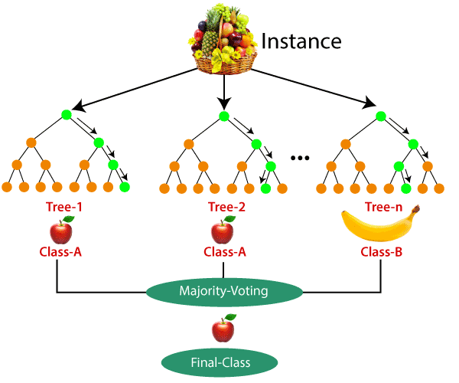
The working of the algorithm can be better understood by the below example:
Example: Suppose there is a dataset that contains multiple fruit images. So, this dataset is given to the Random forest classifier. The dataset is divided into subsets and given to each decision tree. During the training phase, each decision tree produces a prediction result, and when a new data point occurs, then based on the majority of results, the Random Forest classifier predicts the final decision. Consider the below image:

Slide 55
Applications of Random Forest
There are mainly four sectors where Random forest mostly used:
Banking: Banking sector mostly uses this algorithm for the identification of loan risk.
Medicine: With the help of this algorithm, disease trends and risks of the disease can be identified.
Land Use: We can identify the areas of similar land use by this algorithm.
Marketing: Marketing trends can be identified using this algorithm.
Advantages of Random Forest
Random Forest is capable of performing both Classification and Regression tasks.
It is capable of handling large datasets with high dimensionality.
It enhances the accuracy of the model and prevents the overfitting issue.
Disadvantages of Random Forest
Although random forest can be used for both classification and regression tasks, it is not more suitable for Regression tasks.

Slide 56
Support Vector Machine
Generally, Support Vector Machines is considered to be a classification approach, it but can be employed in both types of classification and regression problems. It can easily handle multiple continuous and categorical variables. SVM constructs a hyperplane in multidimensional space to separate different classes. SVM generates optimal hyperplane in an iterative manner, which is used to minimize an error. The core idea of SVM is to find a maximum marginal hyperplane(MMH) that best divides the dataset into classes.

Slide 57
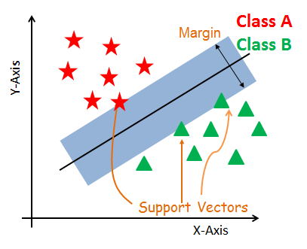

Slide 58
The followings are important concepts in SVM −
Support Vectors
Support vectors are the data points, which are closest to the hyperplane. These points will define the separating line better by calculating margins. These points are more relevant to the construction of the classifier.
Hyperplane
A hyperplane is a decision plane which separates between a set of objects having different class memberships.
Margin
A margin is a gap between the two lines on the closest class points. This is calculated as the perpendicular distance from the line to support vectors or closest points. If the margin is larger in between the classes, then it is considered a good margin, a smaller margin is a bad margin.

Slide 59
How does SVM work?
The main objective is to segregate the given dataset in the best possible way. The distance between the either nearest points is known as the margin. The objective is to select a hyperplane with the maximum possible margin between support vectors in the given dataset. SVM searches for the maximum marginal hyperplane in the following steps:
Generate hyperplanes which segregates the classes in the best way. Left-hand side figure showing three hyperplanes black, blue and orange. Here, the blue and orange have higher classification error, but the black is separating the two classes correctly.
Select the right hyperplane with the maximum segregation from the either nearest data points as shown in the right-hand side figure

Slide 60
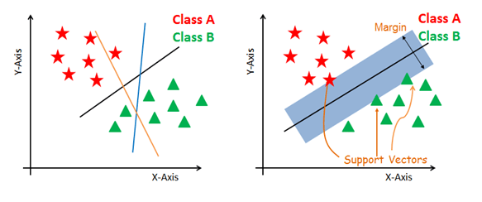

Slide 61
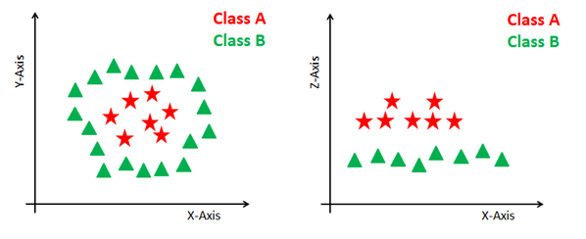
Dealing with non-linear and inseparable planes
Some problems can’t be solved using linear hyperplane, as shown in the figure below (left-hand side).
In such situation, SVM uses a kernel trick to transform the input space to a higher dimensional space as shown on the right. The data points are plotted on the x-axis and z-axis (Z is the squared sum of both x and y: z=x^2=y^2). Now you can easily segregate these points using linear separation.

Slide 62
SVM Kernels
In practice, SVM algorithm is implemented with kernel that transforms an input data space into the required form. SVM uses a technique called the kernel trick in which kernel takes a low dimensional input space and transforms it into a higher dimensional space. In simple words, kernel converts non-separable problems into separable problems by adding more dimensions to it. It makes SVM more powerful, flexible and accurate. The following are some of the types of kernels used by SVM −

Slide 63
Kernel | Formula | When to Use | Notes
Linear | xTyx^T y | Linearly separable data | Fast, simple
Polynomial | (xTy+c)d(x^T y + c)^d | Data with polynomial patterns | Captures interactions
RBF / Gaussian | exp⁡(−γ∥x−y∥2)\exp(-\gamma \|x - y\|^2) | Complex, nonlinear data | Most popular, powerful
Sigmoid | tanh⁡(αxTy+c)\tanh(\alpha x^T y + c) | Neural network-like tasks (rare) | Less common

Slide 64
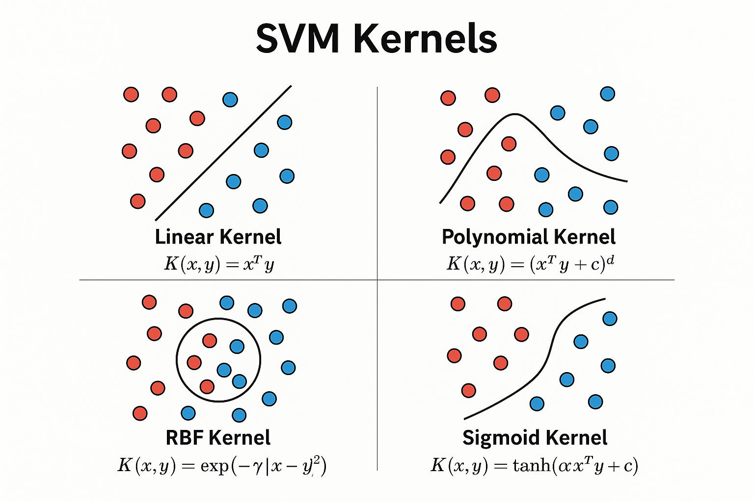

Slide 65
Logistic Regression
Logistic Regression is a supervised learning algorithm used for classification problems. Unlike linear regression which predicts continuous values, logistic regression predicts the probability of a categorical dependent variable (commonly binary – 0 or 1, Yes or No, True or False, etc.).
Use Cases
Spam detection
Disease prediction (e.g., cancer detection)
Customer churn prediction
Credit scoring
Logistic regression is used for classification tasks (especially binary classification) because it predicts probabilities of class membership, not continuous values.

Slide 66
Logistic regression uses the sigmoid (logistic) function, which maps any real-valued number to a range between 0 and 1.
This output can be interpreted as the probability that the input belongs to class 1.
Logistic regression finds a hyperplane (or line) that separates two classes.
Logistic regression is built to handle such discrete outcomes.
Logistic Regression is NOT meant for regression because:
It outputs a probability (between 0 and 1), not a continuous value.
It uses the sigmoid function, which squashes all outputs into the (0,1) range.

Slide 67
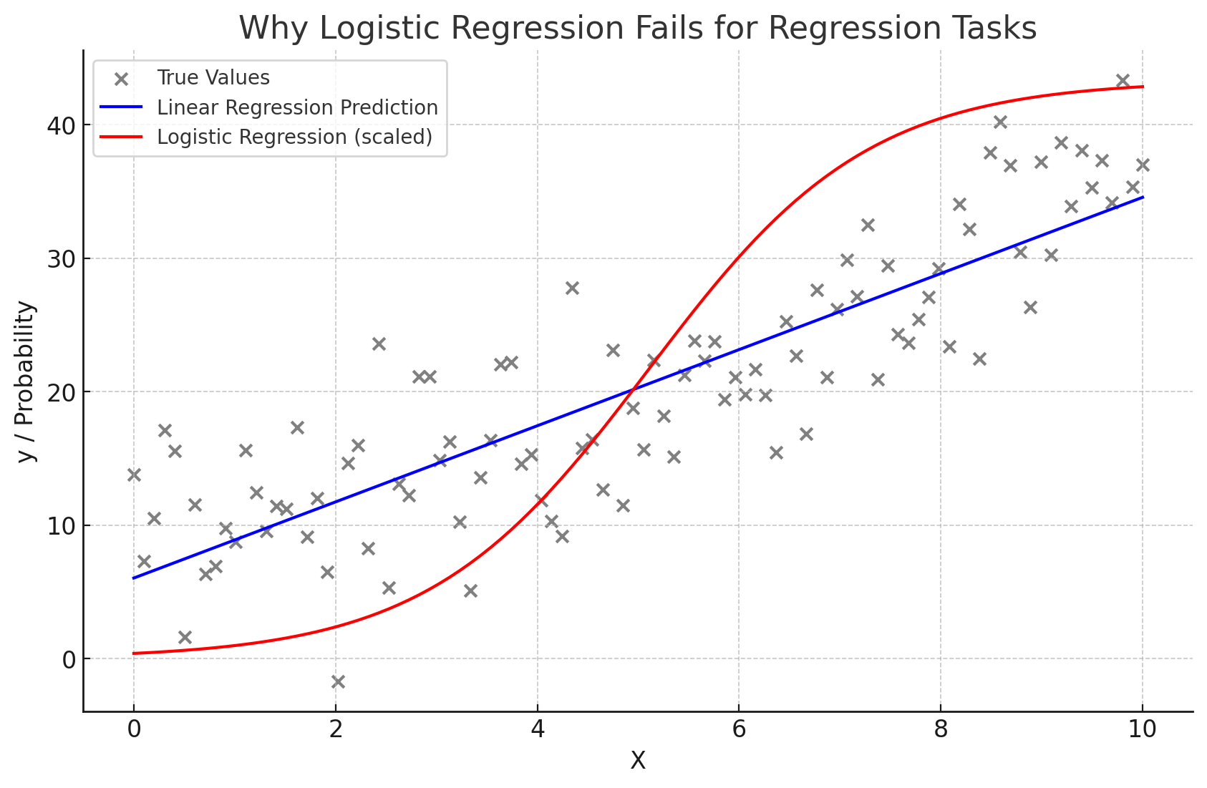

Slide 68
This previous plot demonstrates why logistic regression fails for regression tasks:
Linear Regression (blue line) fits the data by predicting continuous values, matching the overall trend.
Logistic Regression (red curve) outputs probabilities between 0 and 1 (scaled here just for comparison), which do not follow the numeric trend of the original data.
2. Logistic Regression Extends to Multiclass Classification
This is called Multinomial Logistic Regression (or Softmax Regression).
It works when: The target has more than two categories (e.g., class 0, 1, 2). Softmax Function (used in multinomial logistic regression):Instead of the sigmoid, it uses the softmax function to output probabilities for all classes:Each output is between 0 and 1, and the total sums to 1 — perfect for multi-class problems.

Slide 69
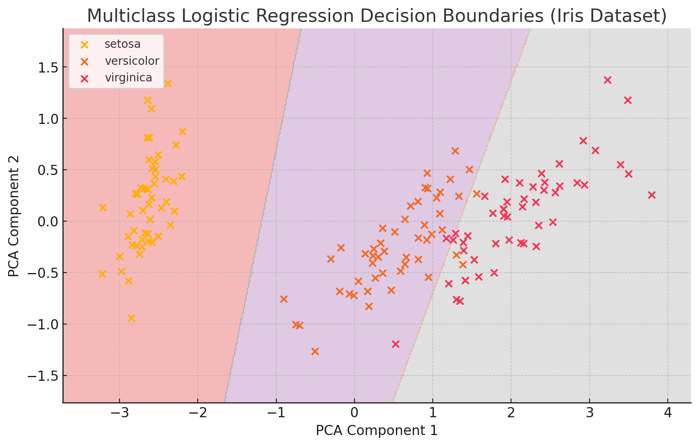

Slide 70
The plot above shows how multiclass logistic regression separates the three classes in the Iris dataset using decision boundaries.
The background colors represent regions classified as one of the three flower species.
Each point is a data sample, and the clusters illustrate how the model predicts based on the input features.
PCA was used to reduce dimensions to 2D for easy visualization.
Now, let’s compare SVM and Logistic Regression,

Slide 71
Feature | Logistic Regression | SVM
Type | Probabilistic classifier | Margin-based classifier
Output | Probability (0-1) | Class label (e.g., -1, 1)
Loss Function | Log Loss (Cross-Entropy) | Hinge Loss
Handles Nonlinear Data | With feature engineering | Yes (using kernel trick)
Robust to Outliers | No | Yes
Gives Probabilities | Yes | No (only with calibration)

Slide 72
Regression Algorithms
Regression is a supervised learning technique which helps in finding the correlation between variables and enables us to predict the continuous output variable based on the one or more predictor variables. It is mainly used for prediction, forecasting, time series modeling, and determining the causal-effect relationship between variables.
In Regression, we plot a graph between the variables which best fits the given data points, using this plot, the machine learning model can make predictions about the data. In simple words, "Regression shows a line or curve that passes through all the data points on target-predictor graph in such a way that the vertical distance between the data points and the regression line is minimum." The distance between data points and line tells whether a model has captured a strong relationship or not.
Some examples of regression can be as:
Prediction of rain using temperature and other factors
Determining Market trends
Prediction of road accidents due to rash driving.

Slide 73
Terminologies Related to the Regression Analysis:
Dependent Variable: The main factor in Regression analysis which we want to predict or understand is called the dependent variable. It is also called target variable.
Independent Variable: The factors which affect the dependent variables or which are used to predict the values of the dependent variables are called independent variable, also called as a predictor.
Outliers: Outlier is an observation which contains either very low value or very high value in comparison to other observed values. An outlier may hamper the result, so it should be avoided.
Multicollinearity: If the independent variables are highly correlated with each other than other variables, then such condition is called Multicollinearity. It should not be present in the dataset, because it creates problem while ranking the most affecting variable.
Underfitting and Overfitting: If our algorithm works well with the training dataset but not well with test dataset, then such problem is called Overfitting. And if our algorithm does not perform well even with training dataset, then such problem is called underfitting.

Slide 74
Types of Regression
Linear Regression
Logistic Regression (used for classification)
Linear regression
Linear regression is a fundamental statistical and machine learning technique used to model the relationship between a dependent variable (target) and one or more independent variables (features). The goal is to fit a line (in simple linear regression) or a hyperplane (in multiple linear regression) that best predicts the target variable based on the input features.

Slide 75


Slide 76
Linear regression is one of the easiest and most popular Machine Learning algorithms. It is a statistical method that is used for predictive analysis. Linear regression makes predictions for continuous/real or numeric variables such as sales, salary, age, product price, etc.
Below is the mathematical equation for Linear regression:
y= a₀+a₁x+ε
Y= Dependent Variable (Target Variable) X= Independent Variable (predictor Variable) a0= intercept of the line (Gives an additional degree of freedom) a1 = Linear regression coefficient (scale factor to each input value). ε = random error

Slide 77
Linear regression is further divided into two:
Simple linear regression
Predicts a continuous target variable using one independent variable.
Equation: y=mx+b
Use Case: Predicting a person's weight based on their height.
Multiple Linear Regression
Uses two or more independent variables to predict a continuous target.
Equation: y=b0+b1x1+b2x2+⋯+bnxn​
Use Case: Predicting house prices based on area, number of bedrooms, and location.

Slide 78
Unsupervised Learning
Unsupervised learning is a type of machine learning in which models are trained using unlabeled dataset and are allowed to act on that data without any supervision.
Types of Unsupervised Learning Algorithms:
1.Clustering - Groups similar data points together
2.Association - Finds interesting relationships between variables
3.Dimensionality Reduction - Reduces number of features while preserving info

Slide 79
Clustering Algorithms
Clustering can be categorized into different types based on the approach used to group the data. Here's a breakdown of the main types of clustering:
Type | Key Idea | Popular Algorithms | Advantages | Disadvantages
Partitioning | Divides data into k non-overlapping clusters | K-Means, K-Medoids | Simple, fast, scalable | Requires pre-defined k, not good for non-spherical clusters
Hierarchical | Builds a hierarchy (tree) of clusters | Agglomerative, Divisive | No need to choose k, dendrogram visualization | Computationally expensive, sensitive to noise
Density-Based | Groups points by regions of high density | DBSCAN, OPTICS | Finds arbitrarily shaped clusters, handles noise well | Fails on varying densities, struggles with high dimensions
Grid-Based | Divides space into a grid and clusters cells | STING, CLIQUE | Fast processing for large datasets | Less accurate with complex or non- uniform distributions

Slide 80
1.Hierarchical Clustering
Hierarchical clustering is another unsupervised machine learning algorithm, which is used to group the unlabeled datasets into a cluster and also known as hierarchical cluster analysis or HCA.
In this algorithm, we develop the hierarchy of clusters in the form of a tree, and this tree-shaped structure is known as the dendrogram.
The hierarchical clustering technique has two approaches:
Type | Description
Agglomerative | Bottom-up approach: Start with each point as its own cluster and merge them iteratively
Divisive | Top-down approach: Start with all data in one cluster and split recursively

Slide 81
Agglomerative Clustering is more commonly used.
How It Works (Agglomerative):
Treat each data point as a single cluster.
Compute the distance (similarity) between all clusters.
Merge the two closest clusters.
Repeat until all points are merged into one cluster.
Plot a dendrogram to visualize.

Slide 82
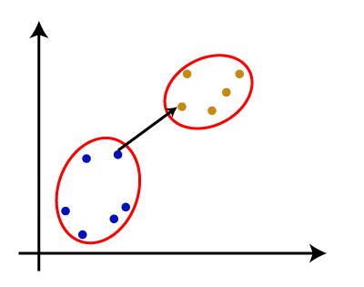
Linkage Methods (to calculate distance between clusters)
There are various ways to calculate the distance between two clusters, and these ways decide the rule for clustering. These measures are called Linkage methods. Some of the popular linkage methods are given below:
Single Linkage: It is the Shortest Distance between the closest points of the clusters. Consider the below image:

Slide 83
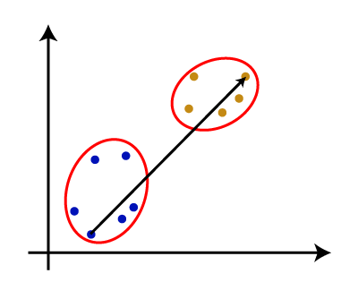
Complete Linkage: It is the maximum distance between the two points of two different clusters. It is one of the popular linkage methods as it forms tighter clusters than single-linkage.

Slide 84
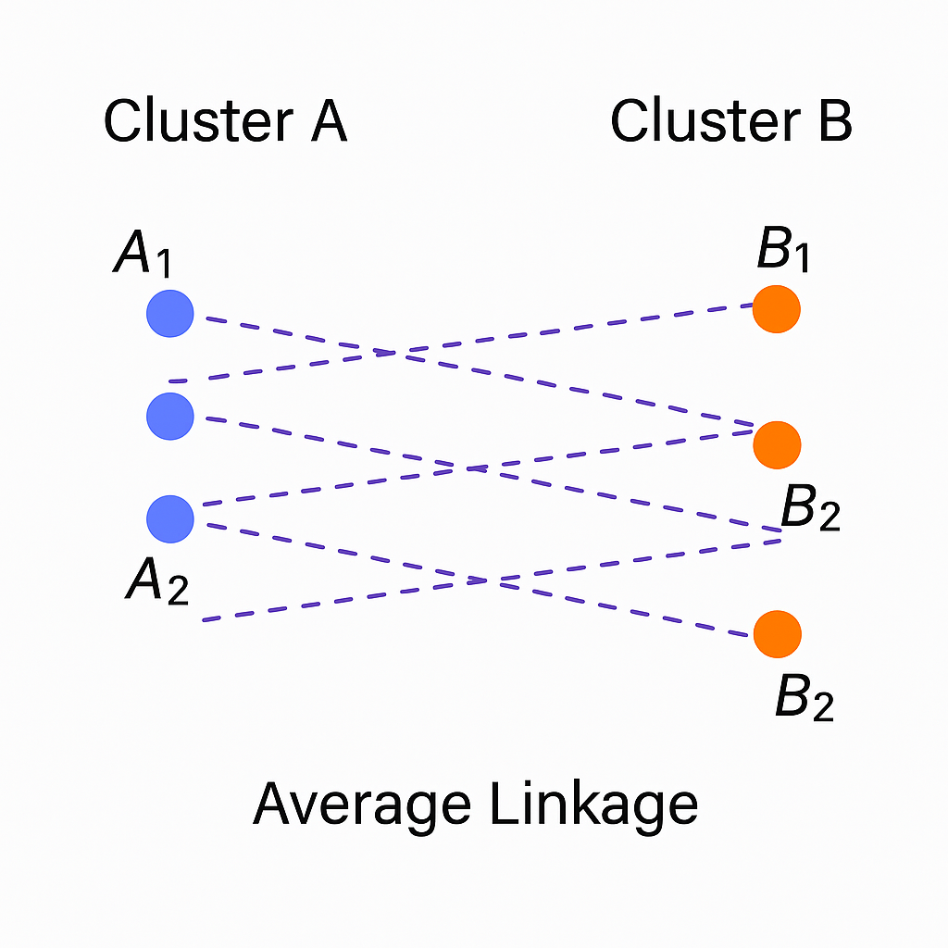
Average Linkage: It is the linkage method in which the distance between each pair of datasets is added up and then divided by the total number of datasets to calculate the average distance between two clusters.

Slide 85
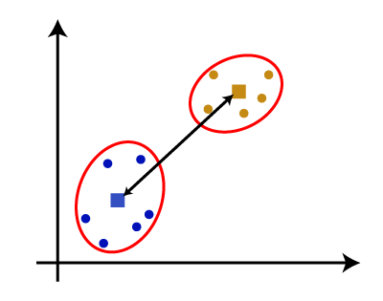
Centroid Linkage: It is the linkage method in which the distance between the centroid of the clusters is calculated. Consider the below image:

Slide 86
K Means Algorithm
2.Partition Based Clustering
K-Means Clustering is an Unsupervised Learning algorithm, which groups the unlabelled dataset into different clusters. Here K defines the number of predefined clusters that need to be created in the process, as if K=2, there will be two clusters
It is a centroid-based algorithm, where each cluster is associated with a centroid. The main aim of this algorithm is to minimize the sum of distances between the data point and their corresponding clusters.
The algorithm takes the unlabeled dataset as input, divides the dataset into k-number of clusters, and repeats the process until it does not find the best clusters. The value of k should be predetermined in this algorithm.

Slide 87
How does the K-Means Algorithm Work?
Select Data - Load the unlabelled data for doing the algorithm.
Choose K – Number of clusters to create.
Initialize – Randomly select K data points as initial centroids.
Assign Step – Assign each point to the nearest centroid (based on Euclidean distance).
Update Step – Calculate new centroids by taking the mean of all points in each cluster.
Repeat Steps 4 & 5 until centroids do not change significantly.

Slide 88
Now let’s explain this with a 2 dimensional data.
Consider the below dataset
x1 | 1 | 2 | 2 | 3 | 4 | 5
x2 | 1 | 1 | 3 | 2 | 3 | 5
2)Select Value of K : Here let’s select it as 2.
3)Choose randomly select 2 cluster center
v1=(2,1)
v2=(2,3)
4)Find the distance between the cluster and each data points.

Slide 89
Data point | Distance from v1(2,1) | Distance from v2(2,3) | Assigned center
A1=(1,1) | 1 | 2.24 | v1
A2=(2,1) | 0 | 2 | v1
A3=(2,3) | 2 | 0 | v2
A4=(3,2) | 1.41 | 1.41 | v1
A5=(4,3) | 2.83 | 2 | v2
A6=(5,5) | 5 | 3.61 | v2
Distance is calculated using the formula: d=sqrt((x1-y1)^2+(x2-y2)^2)
For the first data point,
d=sqrt((1-2)^2 + (1-1)^2)
=sqrt(1+0) =1

Slide 90
5)calculate the average of each cluster
Average of v1
v1=1/3[(1,1) +(2,1) +(3,2)]
=1/3[6,4]
=(2,1.33)
Average of v2
v2=1/3[(2,3)+(4,3)+(5,5)
=1/3[11,11]
=(3.67,3.67)
Here calculated averages is not equal with the centres. so,repeat step 4 and 5 until we get same cluster center or same cluster elements as in the previous iteration.

Slide 91
Association Algorithms
Association rule learning is a type of unsupervised learning technique that checks for the dependency of one data item on another data item and maps accordingly so that it can be more profitable. It tries to find some interesting relations or associations among the variables of dataset. It is based on different rules to discover the interesting relations between variables in the database.
The association rule learning is one of the very important concepts of machine learning and it is employed in Market Basket analysis, Web usage mining, continuous production, etc. Here market basket analysis is a technique used by the various big retailer to discover the associations between items. We can understand it by taking an example of a supermarket, as in a supermarket, all products that are purchased together are put together.

Slide 92
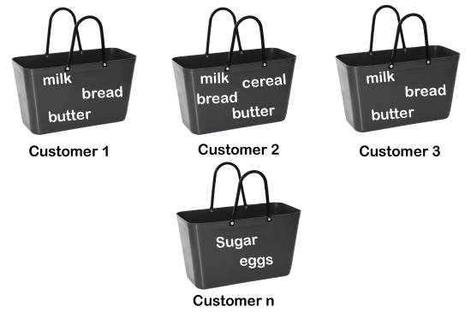
For example, if a customer buys bread, he most likely can also buy butter, eggs, or milk, so these products are stored within a shelf or mostly nearby. Consider the below diagram:

Slide 93
Common Algorithms Are:
Algorithm | Description
Apriori | Iteratively identifies frequent itemsets, then derives rules
Eclat | Uses intersection of itemsets to compute frequent patterns faster
FP-Growth | Builds a prefix-tree to extract frequent patterns efficiently

Slide 94
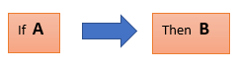
Association can be done with the help of “Association Rule”.The below diagram shows the working of association rule:
How does Association Rule Learning work?
Association rule learning works on the concept of If and Else Statement, such as if A then B.
Here the If element is called antecedent, and then statement is called as Consequent. These types of relationships where we can find out some association or correlation between two items is known as single cardinality. It is all about creating rules, and if the number of items increases, then cardinality also increases accordingly.

Slide 95

So, to measure the associations between thousands of data items, there are several metrics. These metrics are given below:
Support
Confidence
Lift
Support - Support is the frequency of A or how frequently an item appears in the dataset. It is defined as the fraction of the transaction T that contains the itemset X. If there are X datasets, then for transactions T, it can be written as:

Slide 96

Confidence - Confidence indicates how often the rule has been found to be true. Or how often the items X and Y occur together in the dataset when the occurrence of X is already given. It is the ratio of the transaction that contains X and Y to the number of records that contain X.

Slide 97

Lift - It is the strength of any rule, which can be defined as below formula:
It is the ratio of the observed support measure and expected support if X and Y are independent of each other. It has three possible values:
If Lift= 1: The probability of occurrence of antecedent and consequent is independent of each other.
Lift>1: It determines the degree to which the two itemsets are dependent to each other.
Lift<1: It tells us that one item is a substitute for other items, which means one item has a negative effect on another.

Slide 98
Apriori Algorithm
The Apriori algorithm is a classic algorithm in Association Rule Learning. It is used to find frequent itemsets (collections of items that occur together often) and then generate association rules from them.
Association rule mining consists of 2 steps:
1)Find all the frequent itemsets.
2)Generate association rules from the above frequent itemsets.
Why Frequent Itemset Mining?
Frequent itemset or pattern mining is broadly used because of its wide applications in mining association rules, correlations and graph patterns constraint that is based on frequent patterns, sequential patterns, and many other data mining tasks.

Slide 99
Here, apriori is used to find frequent itemsets.
Apriori algorithm was the first algorithm that was proposed for frequent itemset mining. It was later improved by R Agarwal and R Srikant and came to be known as Apriori. This algorithm uses two steps “join” and “prune” to reduce the search space. It is an iterative approach to discover the most frequent itemsets.
The steps followed in the Apriori Algorithm of data mining are:
Join Step: This step generates (K+1) itemset from K-itemsets by joining each item with itself.
Prune Step: This step scans the count of each item in the database. If the candidate item does not meet minimum support, then it is regarded as infrequent and thus it is removed. This step is performed to reduce the size of the candidate itemsets.

Slide 100
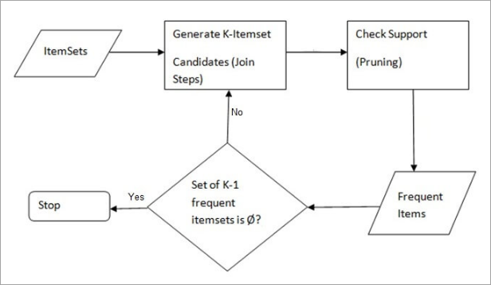

Slide 101
Now let’s do an example for Apriori.let’s consider the below transaction data.
Transaction List of items
T1 I1,I2,I3
T2 I2,I3,I4
T3 I4,I5
T4 I1,I2,I4
T5 I1,I2,I3,I5
T6 I1,I2,I3,I4
Support threshold=50%, Confidence= 60%

Slide 102
Support threshold=50% => 0.5*6= 3 => min_sup=3
Step 1:Find frequent itemset.
1)joining of 1 temset:
Item Count
I1 4
I2 5
I3 4
I4 4
I5 2
2)pruning one itemset:
Above table shows that I5 item does not meet min_sup=3, thus it is deleted, only I1, I2, I3, I4 meet min_sup count.Now the table looks like:

Slide 103
Item Count
I1 4
I2 5
I3 4
I4 4
3)joining 2 itemset:
Item Count
I1,I2 4
I1,I3 3
I1,I4 2
I2,I3 4
I2,I4 3
I3,I4 2

Slide 104
4)Pruning of 2 itemset:
item set {I1, I4} and {I3, I4} does not meet min_sup, thus it is deleted.
Item Count
I1,I2 4
I1,I3 3
I2,I3 4
I2,I4 3
5)Joining of 3 itemset:
Item support count
I1,I2,I3 3
I1,I2,I4 2
I1,I3,I4 2
I2,I3,I4 2

Slide 105
6)Pruning of 3 itemset:
Only {I1, I2, I3} satisfies the minimum support. Rest is deleted.
Step 2:Generate Association Rules
From the frequent itemset we can generate the association rules.here the association rules are the following:
{I1, I2} => {I3}, {I1, I3} => {I2},
{I2, I3} => {I1}, {I1} => {I2, I3},
{I2} => {I1, I3}, {I3} => {I1, I2}
Now let's check the confidence of each rule:
confidence=support(AUB)/support(A)

Slide 106
{I1, I2} => {I3} Confidence = support {I1, I2, I3} / support {I1, I2} = (3/ 4)* 100 = 75%
{I1, I3} => {I2} Confidence = support {I1, I2, I3} / support {I1, I3} = (3/ 3)* 100 = 100%
{I2, I3} => {I1} Confidence = support {I1, I2, I3} / support {I2, I3} = (3/ 4)* 100 = 75%
{I1} => {I2, I3} Confidence = support {I1, I2, I3} / support {I1} = (3/ 4)* 100 = 75%
{I2} => {I1, I3} Confidence = support {I1, I2, I3} / support {I2 = (3/ 5)* 100 = 60%
{I3} => {I1, I2} Confidence = support {I1, I2, I3} / support {I3} = (3/ 4)* 100 = 75%
This shows that all the above association rules are strong if the minimum confidence threshold is 60%.

Slide 107
Advantages
1)Easy to understand algorithm
2)Join and Prune steps are easy to implement on large itemsets in large databases
Disadvantages
1)It requires high computation if the itemsets are very large and the minimum support is kept very low.
2)The entire database needs to be scanned.

Slide 108
Dimensionality Reduction Algorithms
Dimensionality reduction simply refers to the process of reducing the number of attributes in a dataset while keeping as much of the variation in the original dataset as possible. It is a data preprocessing step meaning that we perform dimensionality reduction before training the model.
Why Use Dimensionality Reduction?
Improve model performance by eliminating noise and redundant features.
Speed up computation by reducing data size.
Avoid overfitting by reducing the complexity of models.
Visualization of high-dimensional data in 2D or 3D.

Slide 109
Types of Dimensionality Reduction Techniques
Type | Technique | Description | Use Case
Feature Selection | Filter Methods | Select features based on statistical measures (e.g., correlation,chi-square). | Preprocessing, univariate analysis
 | Wrapper Methods | Use predictive model to evaluate features.(e.g., RFE). | Model-specific feature optimization
 | Embedded Methods | Feature selection is part of the model (e.g.,decision trees). | When using tree models
Feature Extraction | PCA (Principal Component Analysis) | Projects data maximizing variance. | Unsupervised reduction for numeric data
 | LDA (Linear Discriminant Analysis) | Projects data maximizing class separability. | Supervised classification tasks

Slide 110
 | t-SNE | Preserves local structure for visualization in low dimensions. | High-dimensional data visualization
 | UMAP | Preserves both local and global structure efficiently. | Fast and scalable visualization
 | Autoencoders | Neural networks that learn compressed representations of data. | Deep learning and nonlinear reduction
 | Kernel PCA | PCA with nonlinear kernel trick for capturing curved structures. | Nonlinear dimensionality reduction
 | ISOMAP | Preserves geodesic distances between data points. | Manifold learning

Slide 111
Here, we are discussing about features extraction algorithms. Among that PCA and LDA are mostly used. So let’s look them in detail.
1.Principal Component Analysis (PCA)
PCA is a linear dimensionality reduction technique (algorithm) that transforms a set of correlated variables (p) into a smaller k (k<p) number of uncorrelated variables called principal components while retaining as much of the variation in the original dataset as possible. In the context of Machine Learning (ML), PCA is an unsupervised machine learning algorithm that is used for dimensionality reduction.

Slide 112
Aspect | Description
Type | Unsupervised
Goal | Reduce dimensionality by preserving maximum variance in the data
How It Works | - Finds new axes (principal components) that capture the most variance. - Components are orthogonal (uncorrelated) .- First PC captures max variance, second PC the next highest, and so on.
Mathematics | - Compute covariance matrix of data - Compute eigenvectors and eigenvalues - Sort and project data onto top-k eigenvectors
Applications | - Image compression - Noise reduction - Visualization of high-dimensional data
Limitations | - Doesn’t consider class labels - Assumes linear relationships - May lose interpretability

Slide 113
2.Linear Discriminant Analysis(LDA)
Linear discriminant analysis (LDA) is an approach used in supervised machine learning to solve multi-class classification problems. LDA separates multiple classes with multiple features through data dimensionality reduction. This technique is important in data science as it helps optimize machine learning models.

Slide 114
Aspect | Description
Type | Supervised
Goal | Reduce dimensionality by maximizing class separability
How It Works | - Computes between-class and within-class scatter. - Finds linear combinations (discriminants) that maximize the ratio of between-class to within-class variance.
Mathematics | - Compute the within-class scatter matrix - Compute the between-class scatter matrix
Applications | - Classification problems - Preprocessing for supervised learning- Face recognition (Fisherfaces)
Limitations | - Requires labeled data - Assumes normally distributed classes - Not ideal for non-linear boundaries

Slide 115
Difference Between PCA & LDA
Feature | PCA | LDA
Supervision | Unsupervised | Supervised
Objective | Maximize variance | Maximize class separability
Uses Labels? | No | Yes
Output Features | ≤ number of original features | ≤ number of classes - 1
Best For | Data compression, visualization | Classification preprocessing

